Slide 1

Module 5:
Reasoning with
Unbelievers

Slide 2

How can we know anything for sure?

Slide 3
God Revealed Himself
Hebrews 1:1-2
The Christian knows things because the Christian God revealed them.
Hebrews 1:1-2
"God, who at various times and in different ways spoke in time past to the fathers by the prophets, has in these last days spoken to us by his Son, whom He has appointed heir of all things, through whom also he made the world."

Slide 4

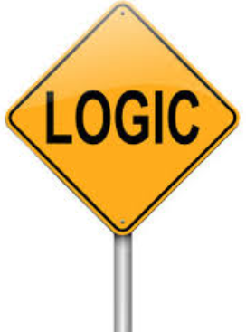



Knowledge from God is:
Transcendant
- UNIVERSAL (same everywhere).
- UNCHANGING (never changes).
- ETERNAL (pre-exists humans).

Slide 5
What is the only way you could know universal, unchanging knowledge that existed before humans?
If God chooses to reveal it.
This is a
Transcendental Argument for God
The point?
We can't be the source of truth.
God is

Slide 6
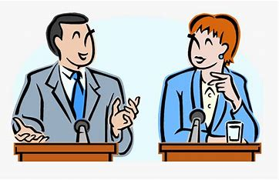
How to Reason
With
Unbelievers

Slide 7
Reasons why the Christian Point Of View is to be preferred over others
Coherence
(not self-contradictory)
Explanatory power
(explains this world and the nature of humans)
Justification Force
(Good reason to believe it)
The impossibility of the contrary
(indirect evidence - abduction)
Notes:
Explanatory power:
-Not unicorn (no justification)
Justification Force:
-"I don't like it" is not a justification.
Does "I don't like it"
provide the possibility
of logic, human dignity, and moral 'oughts'?

Slide 8
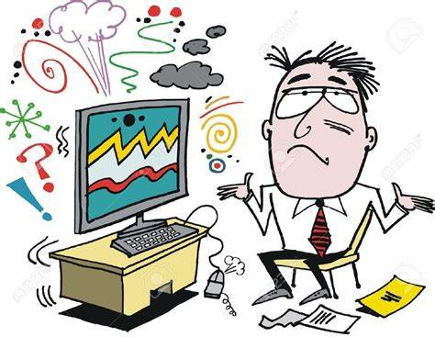
Problems to lookout for
1.) Opinions
and Self-Contradictions
2.) Unargued, privileged beliefs
3.) Sibling Rivalry
4.) Stealing from God

Slide 9

1a.) Identify Opinions
~ 80% of your work is identifying opinions.
The unbeliever will substitute what seems likely, in place of honest research and assesment (no basis)…
i.e. “The Bible was written by some monk in the Dark Ages; there's no way you can know if that's the original. Messages get distored all time.”

Slide 10
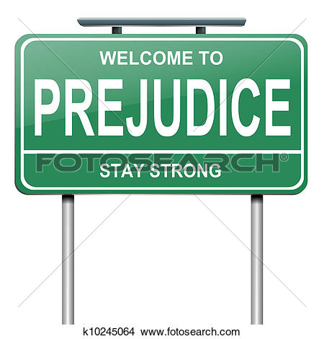
This opinion has a prejudice behind it.
What is the definition of prejudice?
Pre-judging without knowing the facts.
What is the prejudice involved above?
The Bible is an ordinary book like any other, has no unique message or unique authority.

Slide 11
There is evidence for reliability
The evidence we do have would not lead to the result of radical skepticism.
Saying we don't have the real text of the New Testament is engaging in prejudice, not reason. It's being opinionated.
Do NOT be surprised when
the basic assumptions of the unbeliever,
not evidence, are the real reason for rejecting the scriptures.
That is why we must challenge his basic assumptions and demonstrate their absurdity/foolishness/irrationality

Slide 12

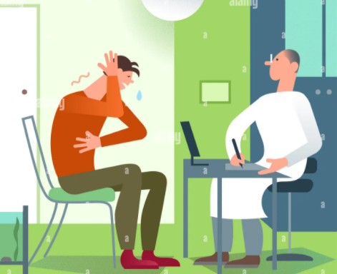
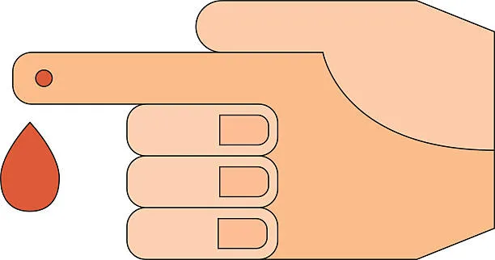
Example where evidence doesn't matter
If your basic assumptions are wrong
the evidence will never convince you.
Scenario of the man who thinks he is dead:
Notes:
Give the story of the man who thinks he is dead.
The doctor shows him graphs of his vitals.
The doctor tells him that if he is NOT dead, then he shouldn't bleed,
then pricks him with a needle to produce blood.
-The living man says, "Wow!, dead mean really do bleed!"

Slide 13

1b.) Identify Self-Contradiction
If you base your beliefs off of opinion and contradict your beliefs, are you behaving rationally?
No!

Slide 14
2. Unargued Privileged Beliefs
The unbeliever has
biased beliefs that are
not argued for, where some beliefs are privileged above others.
Everyone has them.
What we are not ok with is the unargued nature of the biases that people hold,
which are
hostile/antithetical to the Christian Worldview
and are often invisible to the unbeliver.
Notes:
ie.) I like some of the morals of Christianity, but I do not want to be a Christian
ie.) You shoudn't use Christianity as a reason for why laws should be a certain way because not all people are Christians

Slide 15

3. Sibling Rivalry
“Someone's view is built on a prior concept that turns out to disqualify the view itself“.
There is an inner tension that you need to point out.
An example is Epicurus (born in 341 B.C.).
Epicurus could be considered the patron saint of 20th century America.
Here's why...

Slide 16
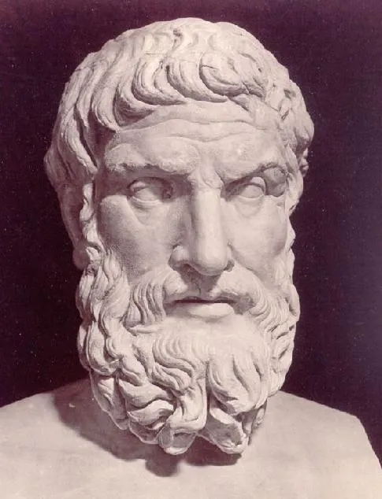
Epicurus
Epicurus believed:
- everything is made of atoms
- live for pleasure without endangering your health (quality mattered)
- How we know things should depend on our sense perception so long as it is not self-contradictory
See any problems? ...

Slide 17

Could Epicurus use his sense perception on these atoms?
No
Was Epicurus making up stuff?
Yes
Is the belief that all knowledge is able to be sensed by human sense perception known based on sense perception?
No

Slide 18
Epicurus:
Believed free will in humans was determined by atoms "swerving“.
Did he know that with his sense perception?
No! He made it up.
Even with electron scanning microscopes today, none are able to perceive sub-atomic particles directly.
What is Epicurus presupposing we have when he says we should live for pleasure.
Free will – that we have a choice.

Slide 19
Free Will and leading atheists...
The late Christopher Hitchens when asked does he believe in free will replies, “I have no choice ".
Lawrence Krauss:
"We can't trace free will back to its source.
It's a question for philosophers to think about, not me.”
The materialist presupposes that someone will eventually find a material way for how free will is possible, which is a faith commitment without basis.
Until then, it is rational to consider Christianity

Slide 20


Expect to get answers as "nobody knows" or "somebody else knows", and "I'm ok with not knowing".
The unbeliever has no basis for free will or choice.
Yet does NOT
live that way.

Slide 21

The internal struggle
Will the unbeliever come up to you and say "hey Christian, I have some internal tension with my beliefs, will you help me figure out why?"
No!
What did we learn from Epicurus?
He said you can only know what you observe.
Then says you know all of the world operates a certain way, which cannot be observed.
Anything learned by human observation is always subject to change upon new observation.
Notes:
-The field of science has changed drastically over the last 1000's of years.
-Just think about how the bible has been right about the nature of man and our world the whole time
-If someone is a truth seeker, they really should be looking to the bible, not only human observation to find truth.

Slide 22

4. Stealing from God
Pay attention when the unbeliever borrows from the Christian worldview that his worldview cannot justify.
i.e. The unbeliever has no basis for moral outrage outside of opinion.
- You need to point out to the unbeliever when he demonstrates he is an imager of God.
The unbeliever can count but can not account for his counting.

Slide 23
Comprehension Questions
What is the only way we could know anything about God?
What are the qualities of transcendant knowledge?
What is 80% of your job when reasoning with the unbeliever? Identifying what?
Notes:
If he revealed it
Unchanging, universal, precedes the universe.
Humans cannot be its cause.
Identifying opinions

Slide 24
What kind of privileged beliefs do we challenge?
What is the real reason the unbeliever rejects the scriptures?
How are unbelievers like Epicurus?
Give an example of stealing from God.
Does anyone remember the example given for evidence can not matter, regardless of how good it is?
Notes:
What kind of privileged beliefs do we challenge?
-ones that are assumed with no justification
What is the real reason the unbeliever rejects the scriptures?
-their unjustified, basic assumptions
How are unbelievers like Epicurus?
-make up whatever seems likely to them.
-you know things by sense perception. pleasure
The unbeliever says there is no God, yet cries about injustice and believes in moral oughts as if they are not opinion

Slide 25

What God tells us
about the unbeliever
What to look out for
when reasoning
with unbelievers

Slide 26

Next Module:
How the unbeliever steals knowledge and
morality from God

Slide 27

End of Module 5
Questions?

